Slide 1
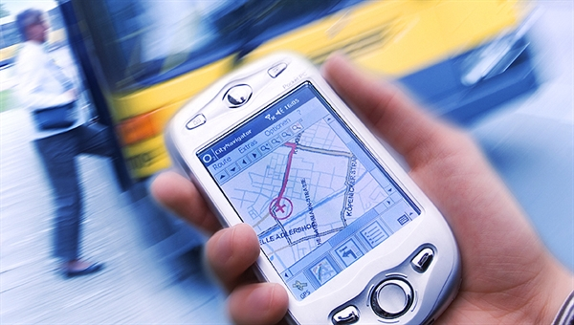
Cloud Computing and Mobile Internet in Development and Implementation of Urban ITS

Slide 2
Intelligent Transport Systems (ITS) apply information and communication technologies to transport. Computers, electronics, satellites and sensors are playing an increasingly important role in our transport systems. The main innovation is the integration of existing technologies to create new services. ITS as such are instruments that can be used for different purposes under different conditions. ITS can be applied in every transport mode (road, rail, air, water) and services can be used by both passenger and freight transport.
Notes:
European Commission about the role of ITS

Slide 3
Mobile Internet Definition
Accessing the Web from smartphones and tablets
An umbrella term for all interaction between mobile devices and the Internet. Also called the "mobile Internet," all apps are initially downloaded from Web servers, and after installation, the great majority of them access Web servers for updates and additional data either periodically or continuously.
Notes:
The new IT technologies such as Mobile Internet and Cloud Computing will realize the new perspectives for ERP, SCADA, including ITS. Consider these technologies.

Slide 4
Cloud Computing Definition
The storing and accessing of applications and computer data offer through a Web browser rather than running installed software on your personal computer or office server
Internet-based computing whereby information, IT resources, and software applications are provided to computers and mobile devices on-demand
Using the Internet to access web-based applications, web services, and IT infrastructure as a service
Notes:
In cloud computing, the word cloud is used as a metaphor for "the Internet," so the phrase cloud computing means a type of Internet-based computing.

Slide 5
Models of Cloud Computing Cloud Deployment models
Infrastructure as a Service (IaaS)
Platform as a Service (PaaS)
Software as a Service (SaaS)
Network as a Service (NaaS)
Public Cloud
Private Cloud
Community Cloud
Hybrid Cloud
Notes:
There are also four models

Slide 6
Advantages of Cloud Computing
Cost Efficiency
Convenience and continuous availability
Backup and Recovery
Cloud is environmentally friendly
Resiliency and Redundancy
Scalability and Performance
Quick deployment and ease of integration
Increased Storage Capacity
Device Diversity and Location Independence
Smaller learning curve

Slide 7
Disadvantages of Cloud Computing
Security and privacy in the Cloud
Dependency and vendor lock-in
Technical Difficulties and Downtime
Limited control and flexibility
Increased Vulnerability

Slide 8
Conclusion about Cloud Computing
We can hope that the advantages will further grow and the disadvantages will be mitigated.
Despite its disadvantages and the fact that it is still in an infant age, Cloud Computing remains strong and has great potential for the future. Its user base grows constantly and more big players are attracted to it, offering better and more fine tuned services and solutions.

Slide 9
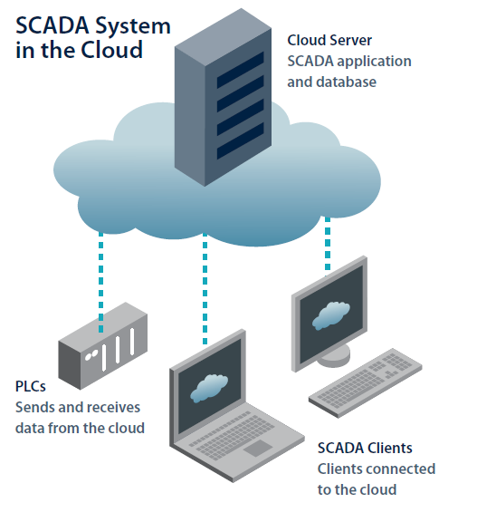
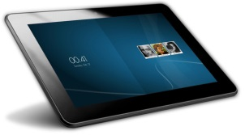
Cloud and Internet- Mobile SCADA Architecture
Notes:
Here is general architecture of Cloud and Internet-Mobile SCADA. PLC may be mobile- smartphone. Client may be mobile- tablet.

Slide 10
Hunedoara county ITS for monitoring passenger transport
Notes:
Permit me to present 2 projects on Mobile Internet and Cloud Computing Technologies for Urban ITS. The first project is:

Slide 11
Hunedoara county ITS for monitoring passenger transport
Notes:
Bluetooth headphone

Slide 12
Hunedoara county ITS for monitoring passenger transport
Notes:
Infrared Sensor for accounting the passengers

Slide 13
Hunedoara county ITS for monitoring passenger transport

Slide 14
Hunedoara county ITS for monitoring passenger transport

Slide 15
Hunedoara county ITS for monitoring passenger transport
Advantages
Exterior:
Operative informing passengers at bus stops display and smartphones about the arrival time of vehicles
Waiting time reduction
Useful announcements (time, weather,
route change etc.) and advertisement

Slide 16
Hunedoara county ITS for monitoring passenger transport

Slide 17
Hunedoara county ITS for monitoring passenger transport
Notes:
Unfortunately this project was not implemented (not passed threshold FP7 of EU)

Slide 18
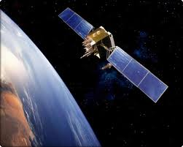
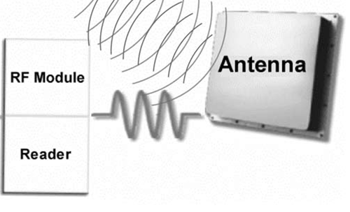
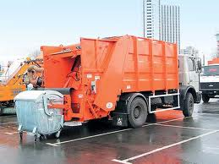
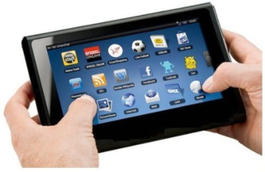
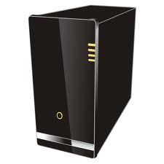
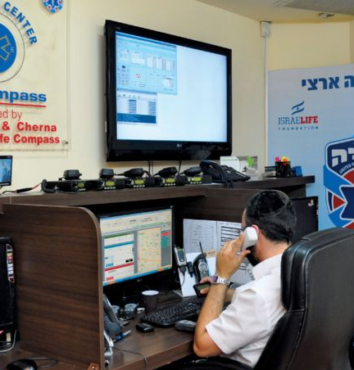
SCADA- system of cleaning of garbage containers
RFID-Sensor - Bluetooth
GPS
Mobile Administration
WEB-Portal-Server
3G Mobile
Cloud services
Internet
Dispatcher
Notes:
The second project was successfully implemented in Chisinau city on Autosalubritate company

Slide 19
SCADA- system of cleaning of garbage containers
Mobile Interface 1
Notes:
Login

Slide 20
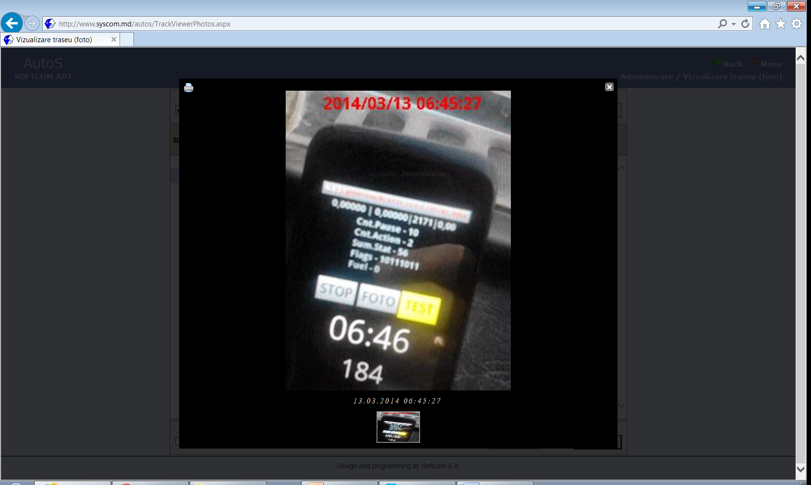
SCADA- system of cleaning of garbage containers
Mobile Interface 2
Notes:
Smartphone in cabin of vehicle. Operating mode.

Slide 21
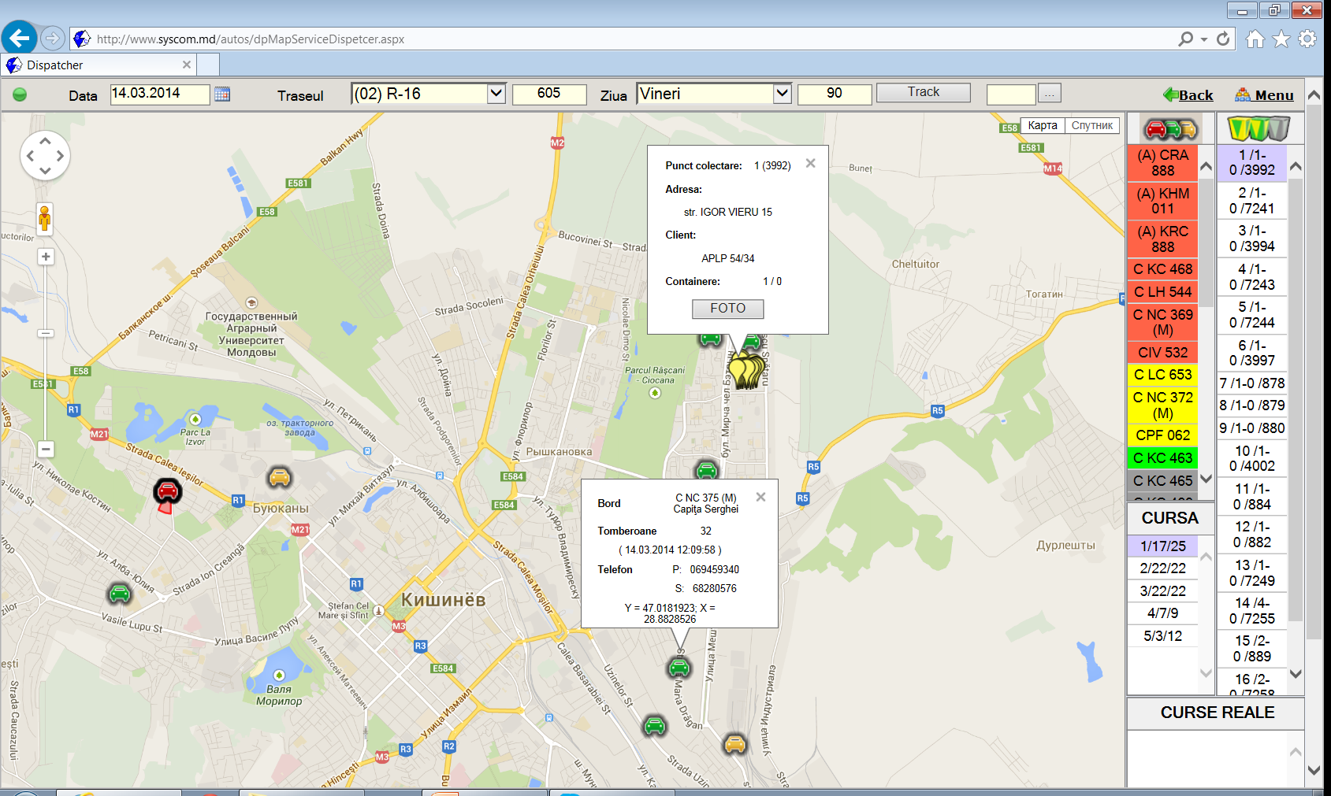
SCADA- system of cleaning of garbage containers
Dispatcher’s interface 1
Notes:
Here we see the cars and customers.

Slide 22
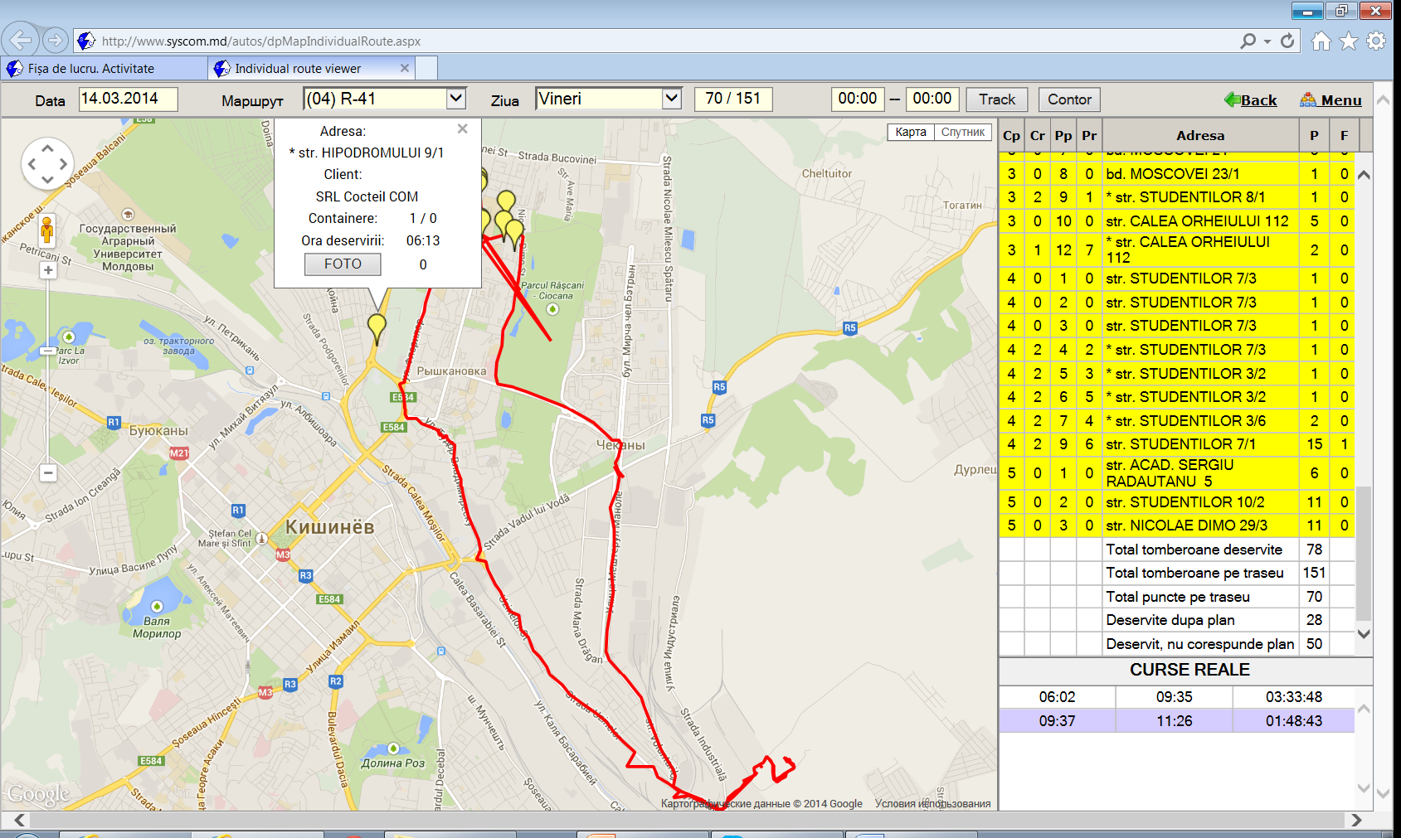
SCADA- system of cleaning of garbage containers
Dispatcher’s interface 2
Notes:
Here we see points of collection of garbage containers and track of vehicle

Slide 23
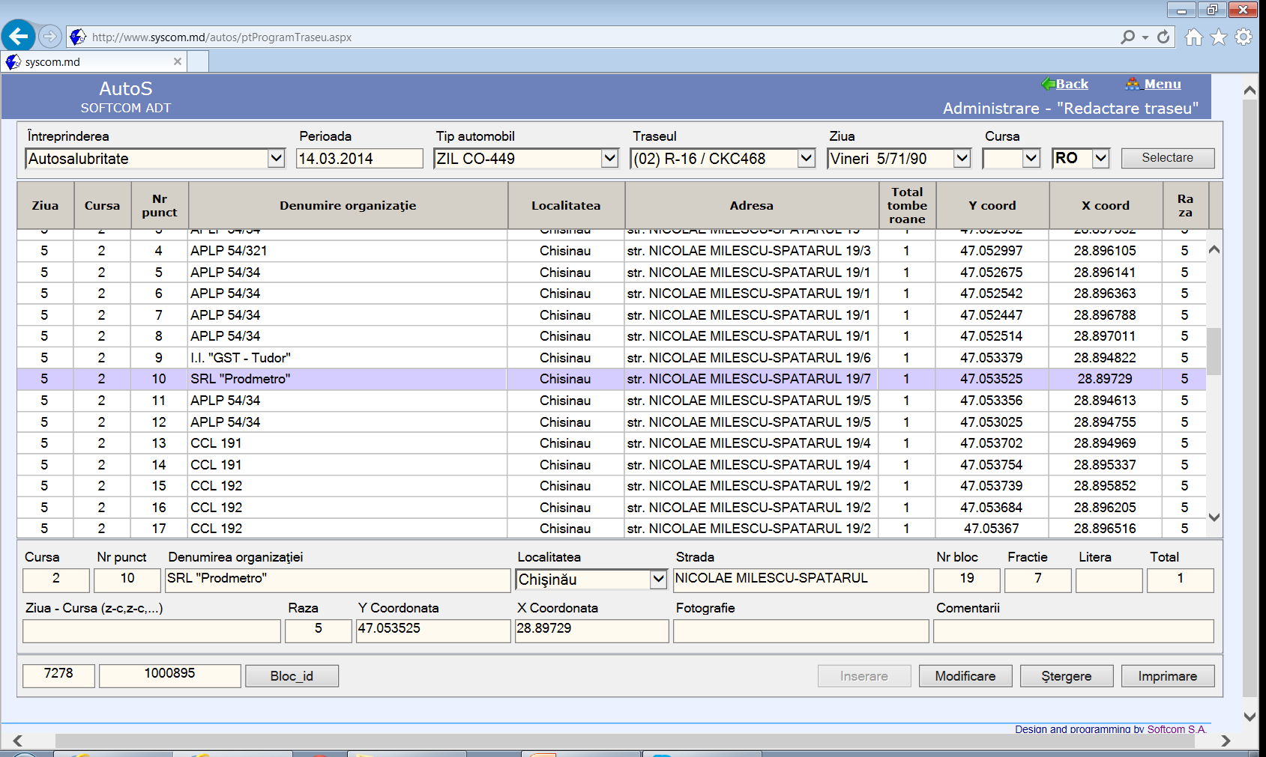
SCADA- system of cleaning of garbage containers
Database
Notes:
Here we see Database of clients (companies).

Slide 24
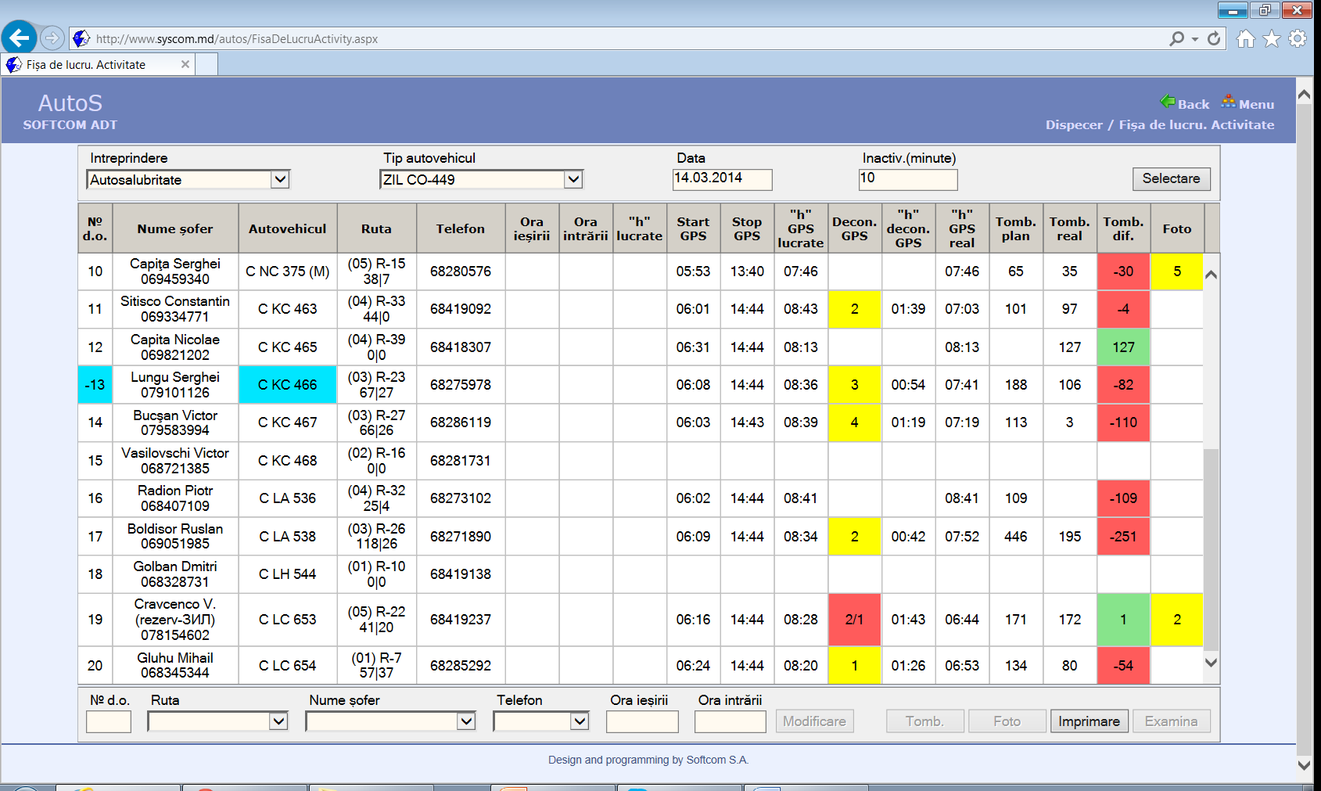
SCADA- system of cleaning of garbage containers
Report 1
Notes:
Here we see one of reports for vehicles

Slide 25
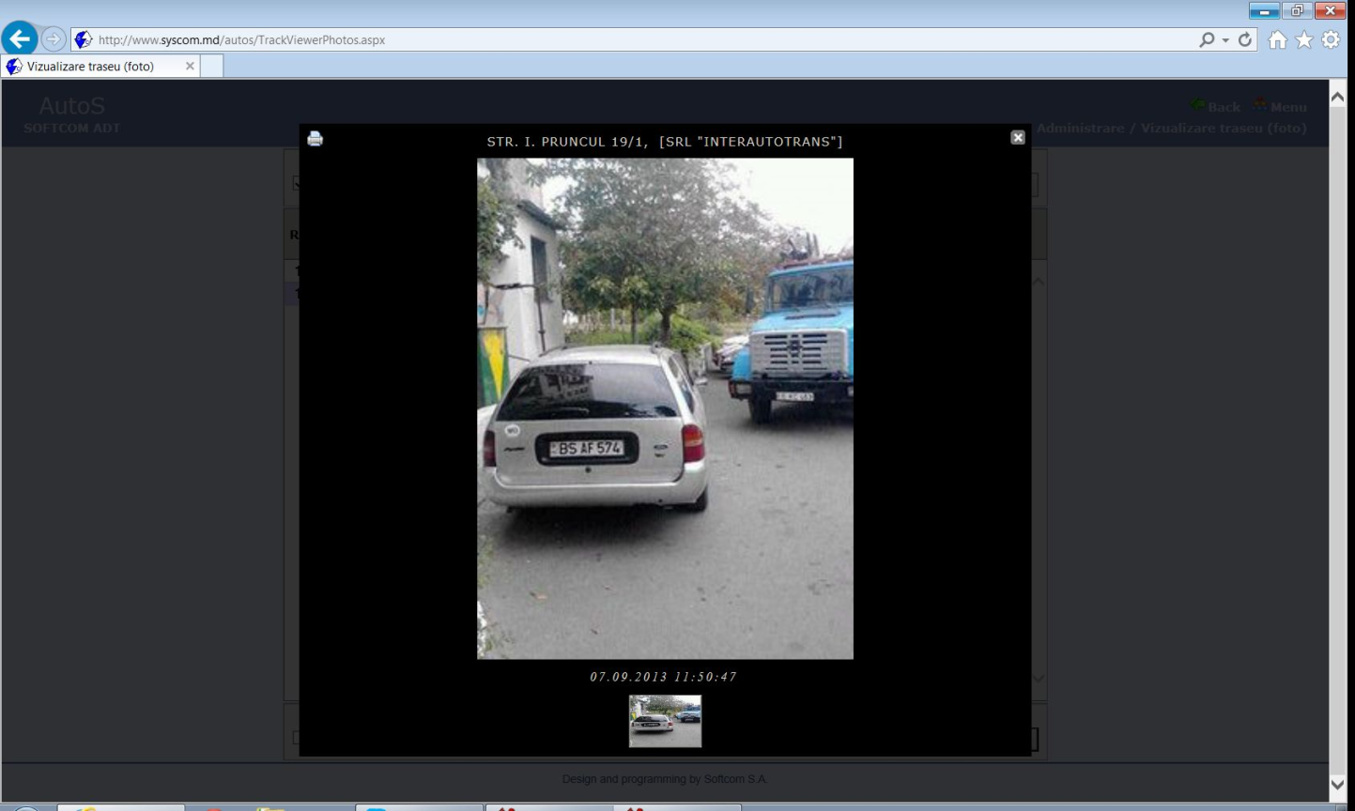
SCADA- system of cleaning of garbage containers
Report 2
Notes:
Here we see the picture report of vehicle driver about impossibility of cleaning of the garbage containers because car prevent. Client shall provide access. The work is executing on base of contract.

Slide 26
SCADA- system of cleaning of garbage containers
Advantages
In the exploitation period of ITS was increased the quality of clients services,
was automated routine work (reports) ,
was disciplined the work of drivers and administrative staff.

Slide 27
END
Thank your for your attention!
Any questions?

